Slide 1

Sex as Deviance
Notes:
Image: storefront in Paris

Slide 2
Vice: a bad habit, a personal failing, or a character flaw
Morality: personal or group principles that distinguish between right/wrong, good/bad and serve as guidelines for behavior
Moral entrepreneurs: individuals or groups that frame social concerns as a moral issue and work to have their concerns reflected in policy or law
Moral panics: periods of intense social concern over particular social phenomenon where the concern is disproportionate to any concrete harm or threat

Slide 3
Social control: the entire range of responses a society uses to address norm violations (review)
Relative: varies across time and place (when and where)
Contextual: depends on specific social situations (settings)
Contingent: depends on factors outside of behavior, attitudes, or characteristics (statuses)
Probabilistic: likely but not definitive

Slide 4
Research Challenges
Funding restrictions (unless tied to public health)
Distrust/Courtesy stigma
Essentialist thinking

Slide 5
Essentialism: the idea that certain traits, qualities or characteristics are innate and rooted in biology
Views sexual behavior and an interest in sex as “natural” and necessary
Sex is “acultural” and “ahistorical” (independent of culture and history)
Can/should be managed or regulated by social controls

Slide 6
Medicalization and Criminalization
Medicalization: definition of behavior or phenomenon as a medical concern, often with the mandate that the medical profession provide treatment or management
Criminalization: definition of behavior or phenomenon as a social threat to the larger society, often resulting in a legal restriction or formal social control

Slide 7

Four Research Traditions
Experimental
clinical
Descriptive
Social bookkeeping

Slide 8
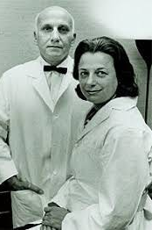

Experimental and Clinical Traditions
Influenced by essentialism
Focused on the “brain/body” connection
Experimental (physiological)/Clinical (psychological)
Contributions and concerns
Construction of deviance
Notes:
William Masters and Virginia Johnson

Slide 9
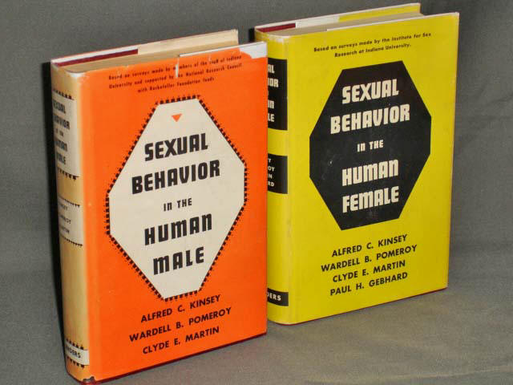
Descriptive and Social Bookkeeping Methods
More common in sociological research
Descriptive (ethnographic) – “narrow but deep”
Social Bookkeeping (surveys) – “wide but shallow”
Construction of deviance

Slide 10
Kinsey
Population surveys in the 1940s – 1950s (interview-based)
Publications: “Sexual Behavior in the Human Male/Sexual Behavior in the Human Female” (1948/1953)
Contributions: demonstrated participant interest, added “respectability”, opens space for public discussion, additional research funding
Influence: sexuality as a continuum, ethic of “tolerance”, contributed to the Sexual Revolution, destabilized conceptions of “normal and abnormal”
Critiques: “laundry list”, biased sample, conflated behavior and identity

Slide 11
Sex in America Study
Late 1980s/1990s
Public health funding
Political flashpoint
Findings supported high rates of “conventionality”

Slide 12
Findings from the
General Social Survey (GSS)and National Survey of Sexual Health and Behavior (NSSHB)*
Relative changes from deviance to conventional (“premarital” sex)
High consensus consistency (“cheating”)
Changing consensus
(monogamy)
Notes:
*NSSSHB now decommissioned, funding split between National Survey of Sexual Wellbeing, National Survey of Family Growth, Youth Risk Behavior Survey

Slide 13
Pluralistic ignorance: a belief that one’s own views/choices is different from the majority’s views/choices
Can represents a gap in the actual group norm and the perceived group norm
Can lead to individuals suppressing their own beliefs and/or changing their desired behavior to conform to what they perceive as the group norm
Can lead to groups collectively maintaining norms that in fact most group members privately/individually reject

Slide 14
Departing from Deviance: Sexual identities other than “straight”
Majority support for same sex partnerships, legal marriage and parenting*
Increasing negative views of homophobia
Positive attitudes correlated with age, education, and (somewhat) religion
Notes:
*down below 50% for people who identify as Republican since 2022

Slide 15
Explaining Attitude Shifts
Institutionalization Support: decline in medicalization (ex. APA 1973), decriminalization (ex. Lawrence v. Texas 2003), expansion of rights (ex. Obergefell v. Hodges 2015, Bostock v. Clayton 2020)
Period Effects: changing visibility and representation in culture
Cohort Replacement: population changes

Slide 16
Acceptance or tolerance?
Homonormativity: increased social acceptance of sexualities outside of heterosexuality that is dependent on the mirroring of (hetero) normative values and behaviors
Boundary Maintenance: the mechanisms and processes through which societies strengthen and enforce norms
The myth of inevitable progression

Slide 17
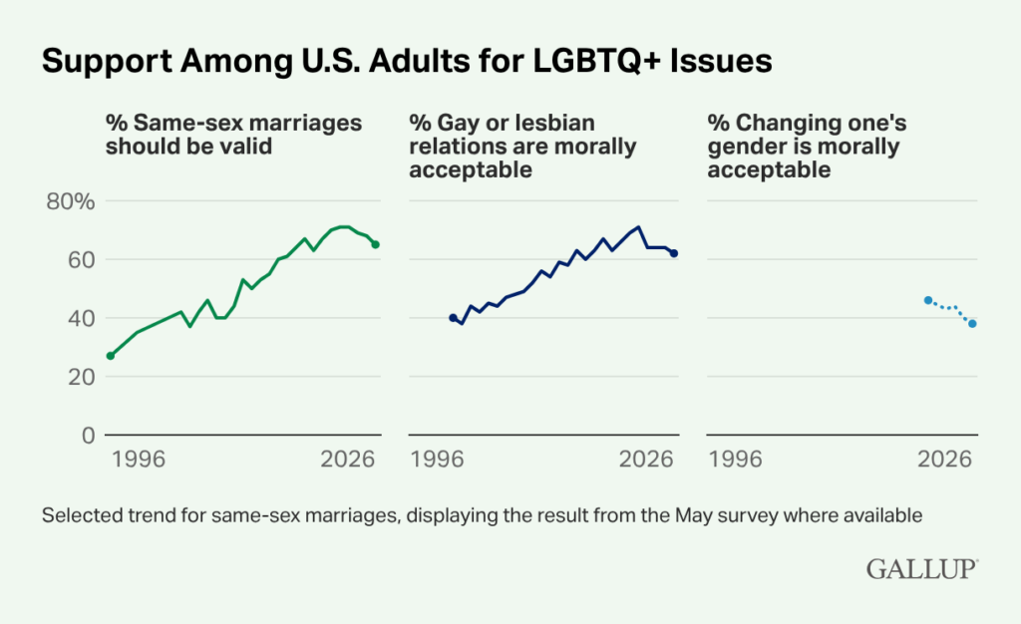

Slide 18
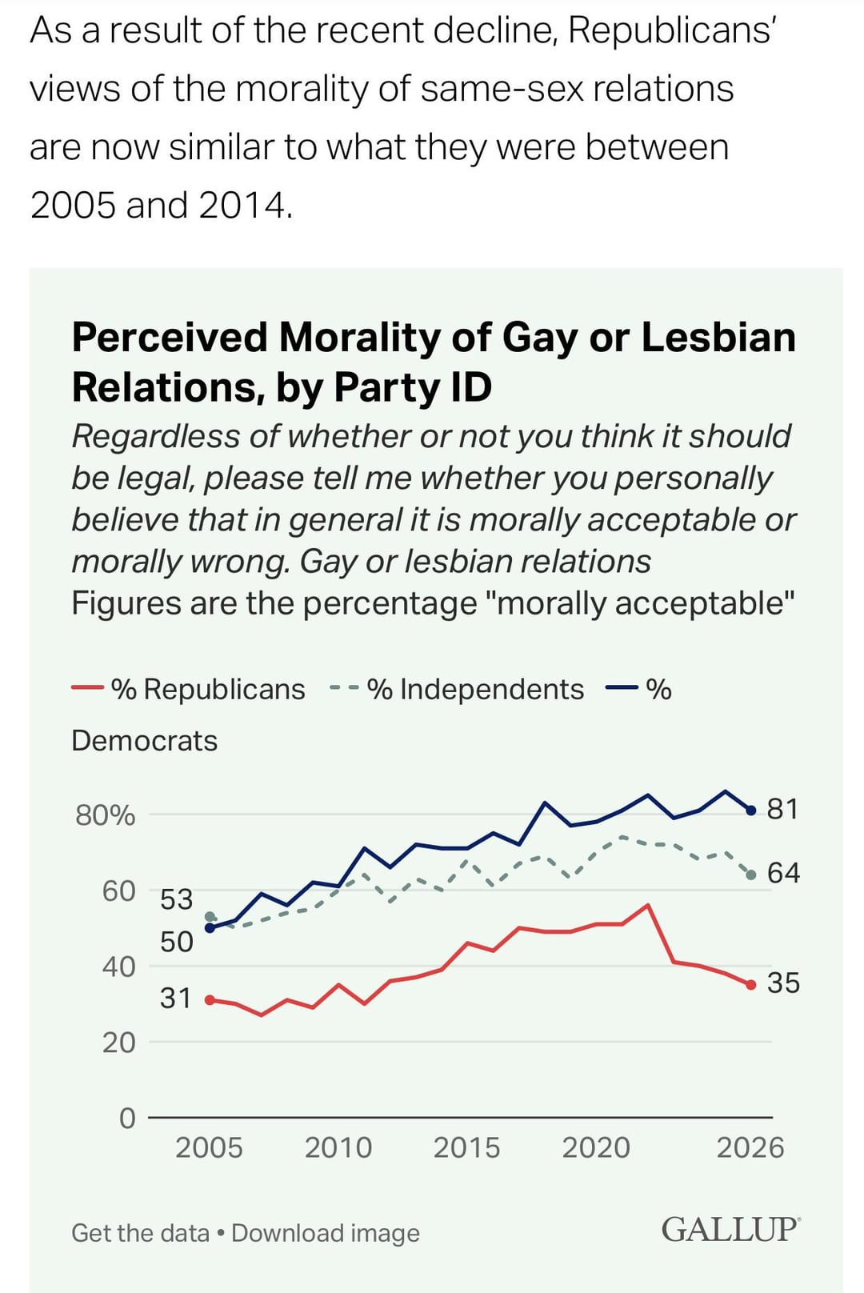

Slide 19
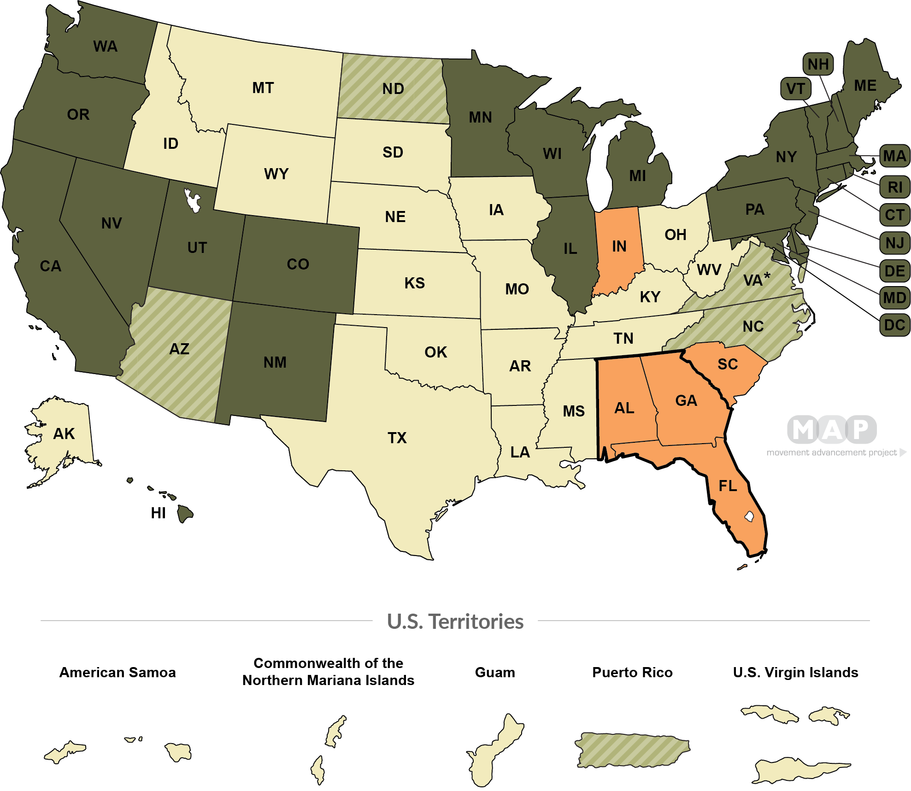
Notes:
Dark green: Prohibits licensed health care providers from treating minors, Green stripe: restricts but does not prohibit, Yellow: no state law or policy Orange: court rulings routinely overrule local restrictions https://mapresearch.org/equality-map/conversion-therapy-laws/

